Slide 1
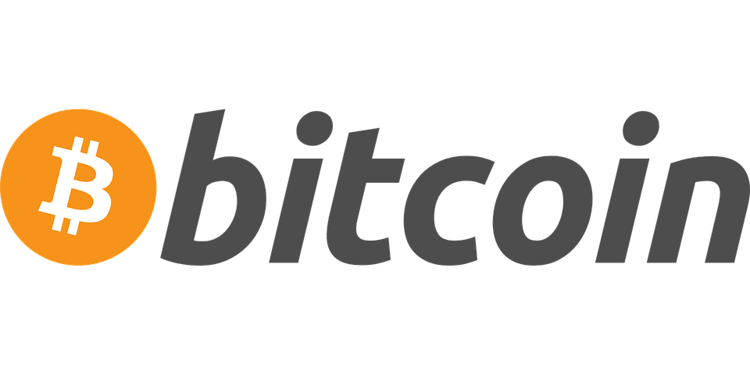



Intro to Bitcoin
http://bit.ly/DC-BTC

Slide 2
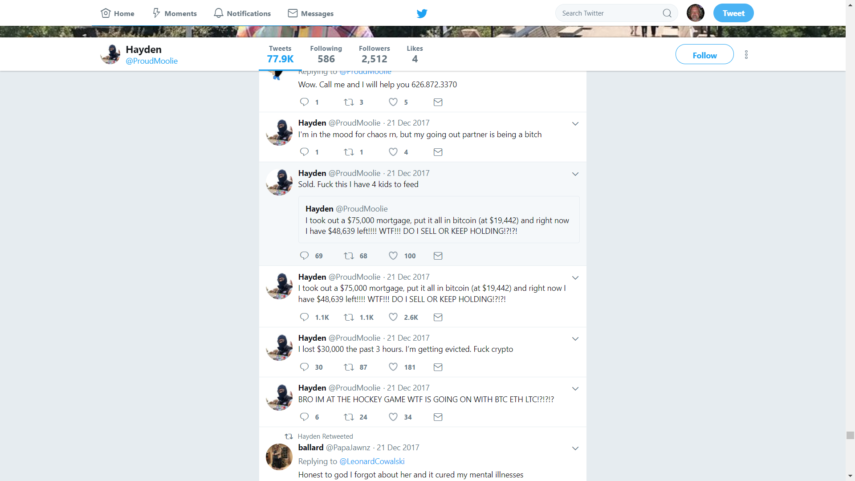
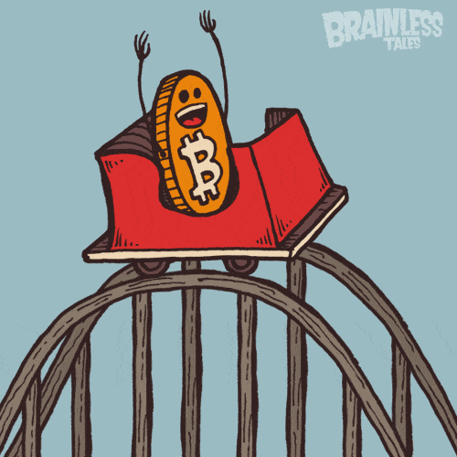
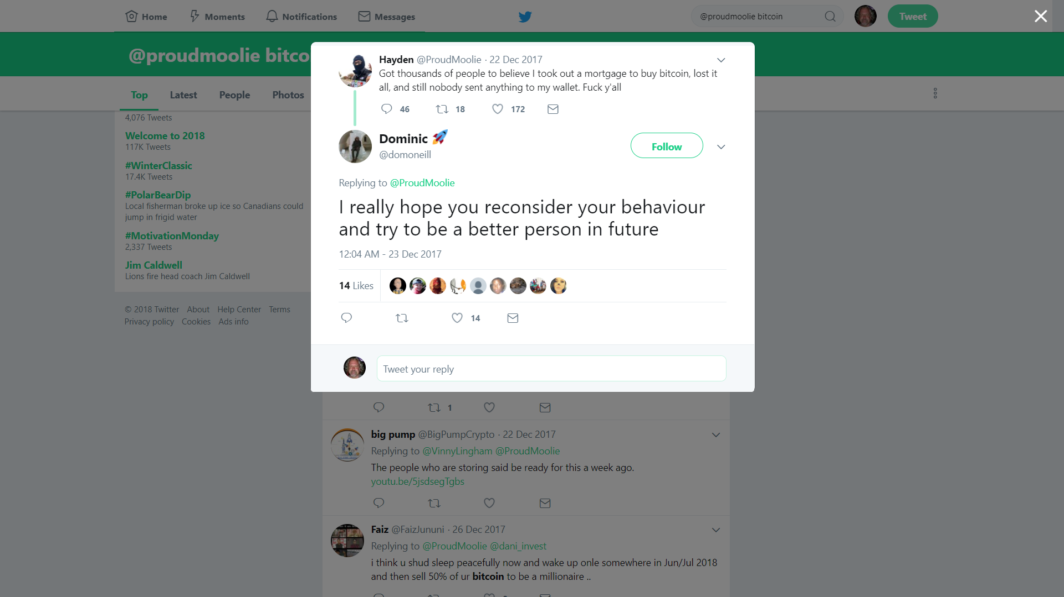

*** Disclaimer ***
Investing in Cryptocurrencies:
Requires knowledge and effort to mitigate the many risks involved
Your bank won’t protect you here
This presentation is only the beginning...
Requires investment experience and discipline to ensure you don’t make poor financial decisions
Buy low, be patient, sell high
Requires a commitment to continuous learning and research; this field moves and changes quickly
Be Prepared For:
Volatility that brings huge swings in value
Financial loss potential due to:
RTFM mistakes
Hackers and scammers
Corrupt teams
Bugs and poor support services
Technical innovations that devalue other coins
And other crazy shit
Notes:
Millionaire ICO example – going to bed with nothing, waking up with everything back
RTFM mistake: using a Bitcoin Cash address for sending Bitcoin. And, it’s gone.

Slide 3
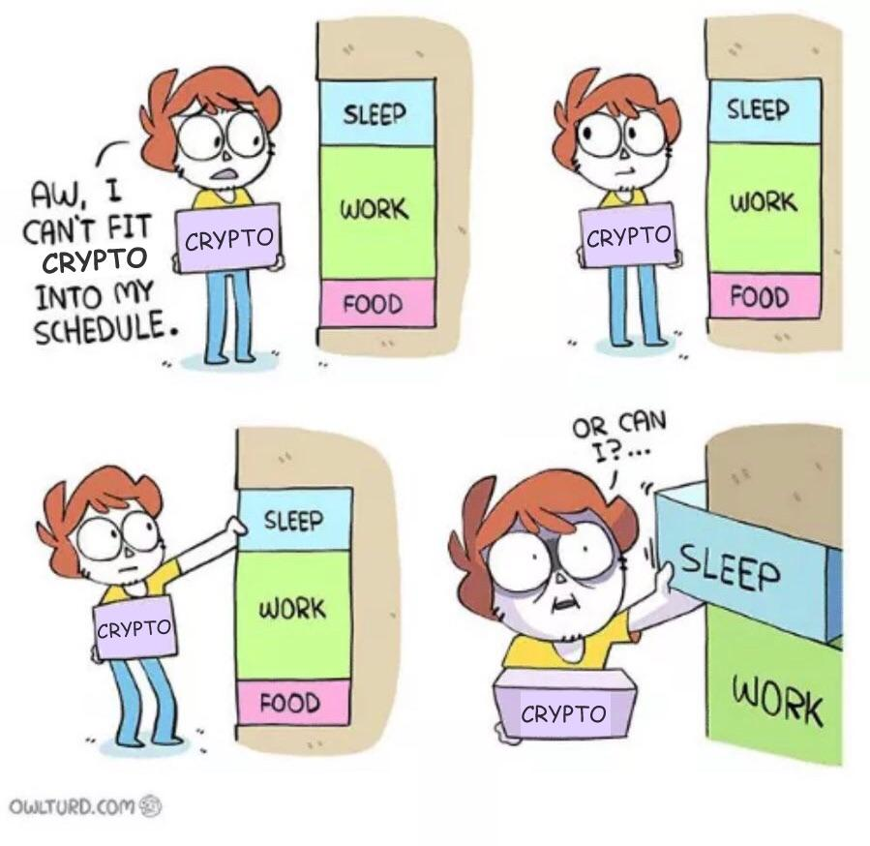
Topics
What is Money?
What is Bitcoin?
Cryptocurrencies
Buying, Selling, and Trading Crypto
Crypto Price Theories
Crypto Tips
Out of Scope Today
Mining Cryptocurrency
Blockchain and Other Crypto Technologies
Bitcoin and Altcoin Forks
Crypto Software Development
Bitcoin and Energy Usage
Satoshi Nakamoto Theories
Advanced Trading Topics
Trading pairs
Tether concerns
Initial Coin Offerings (ICOs)

Slide 4
What is Money?
A medium of exchange
An alternative to bartering
Has purchasing power
Established by history, supply and demand, and social convention (or consensus)
Made legal tender by fiat (order) of the government
Legal tender must be accepted as payment
Hence the term fiat currency
Paper money and coins have little or no intrinsic value in themselves, except the value society gives them

Slide 5
The Value of Money
Owning money does not guarantee future value
Value of money changes over time
Value is based on supply and demand
Supply is managed by central and chartered banks
Printing money causes inflation
Demand is driven by confidence, expectations
Strength of the political system and it’s economic infrastructure
Notes:
Money is held by people, organizations, and foreign governments
Foreign governments that hold lots of currency can have an adverse effect on inflation in a country

Slide 6
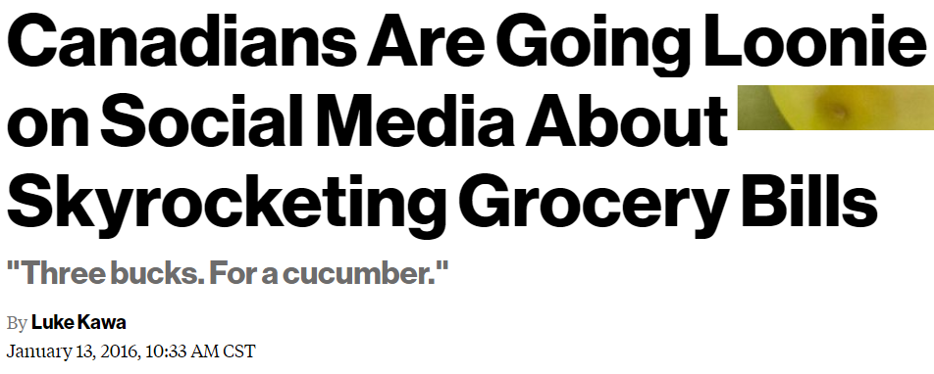
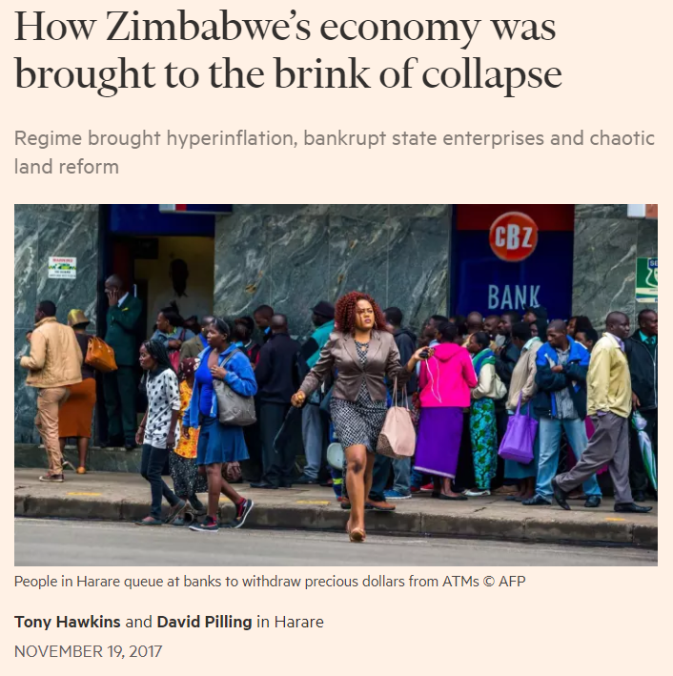
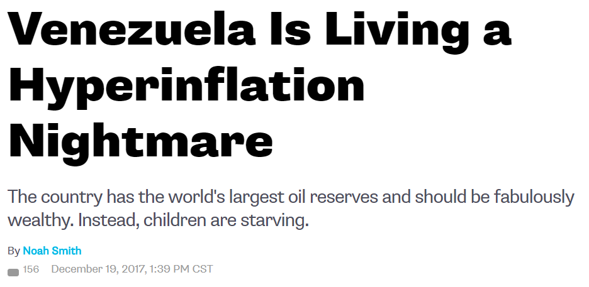
Currency Risks
Notes:
Inflation caused by many sources can have a horrific effect on a country.

Slide 7


What is Bitcoin?
A transferrable, digital asset
Cryptography is used to secure access, hence the terms:
Crypto-coins
Cryptocurrency
Money – but not fiat currency
It is a medium of exchange
It is valued through supply and demand
It is accepted by 100,000+ merchants worldwide
Open source software
Canadian examples
Notes:
https://www.zerohedge.com/news/2017-05-28/who-accepts-bitcoins-payment-list-companies-stores-shops

Slide 8

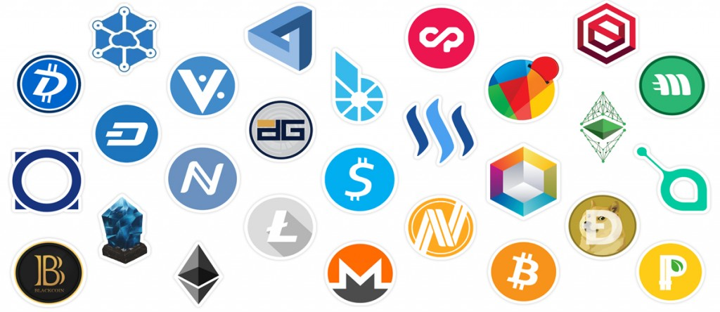
Cryptocurrencies: Bitcoin & Altcoins
1,000+ are listed on
Notes:
There are thousands of crypto coins out there.
CoinCap is one site that tracks the current price and market cap of many coins.

Slide 9
Cryptocurrency Diversity
Can be completely virtual/digital
Can be distributed and community led
Can be mined with software
Can be traded like a stock or commodity
Can be used to purchase goods and services generally
Can be pseudo or fully anonymous transactions
Can relate to real-world assets
Can be centralized and corporate led
Can be mined via ownership
Can be invested in via index funds and futures
Can be used to acquire specific goods and services
Can be identified or named transactions
And/ Or

Slide 10



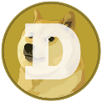
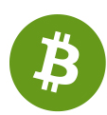


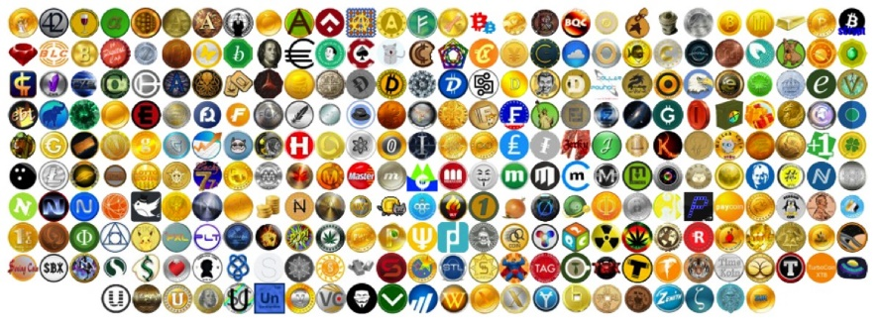
Altcoin Examples
Ethereum (ETH): Distributed computing platform with smart contracts
Dogecoin (DOGE): Decentralized, tipping coin which is great for learning about crypto
Monero (XMR): Focused on privacy, decentralization, and scalability.
Unikoingold (UKG): eSports skill-based and spectator-based wagers.
CreativeChain (CREA): For certifying the authorship and licensing of creative works.
Bitcoin Cash (BCH): A fork of Bitcoin focused on esoteric technicalities.
There are several Altcoins that are gold-backed or focused on oil, cannabis, or memberships.
Plus many, many more

Slide 11
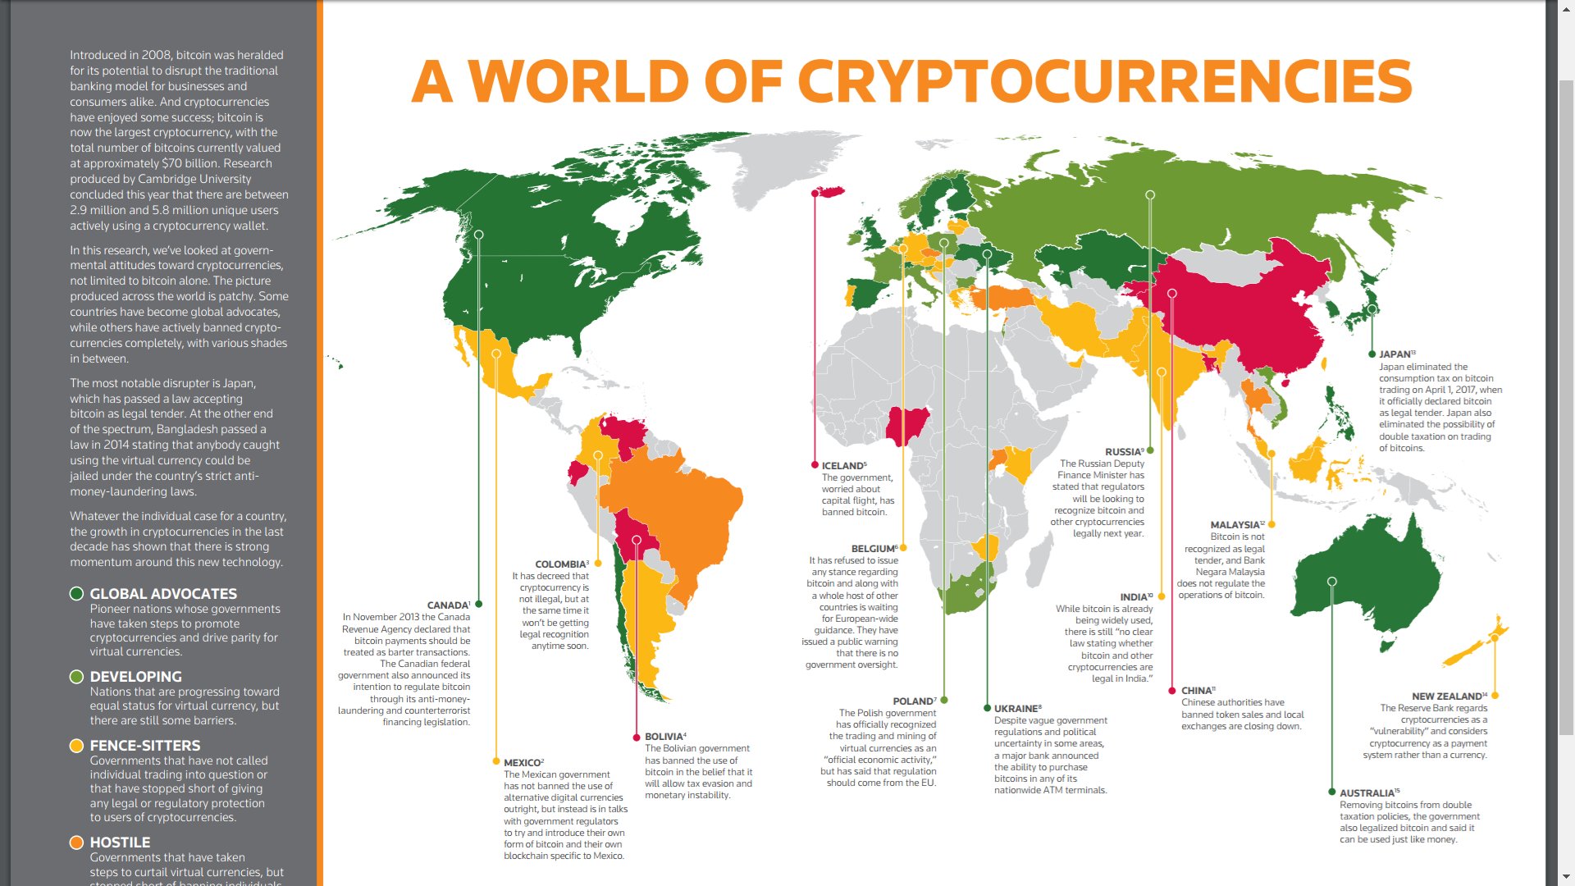
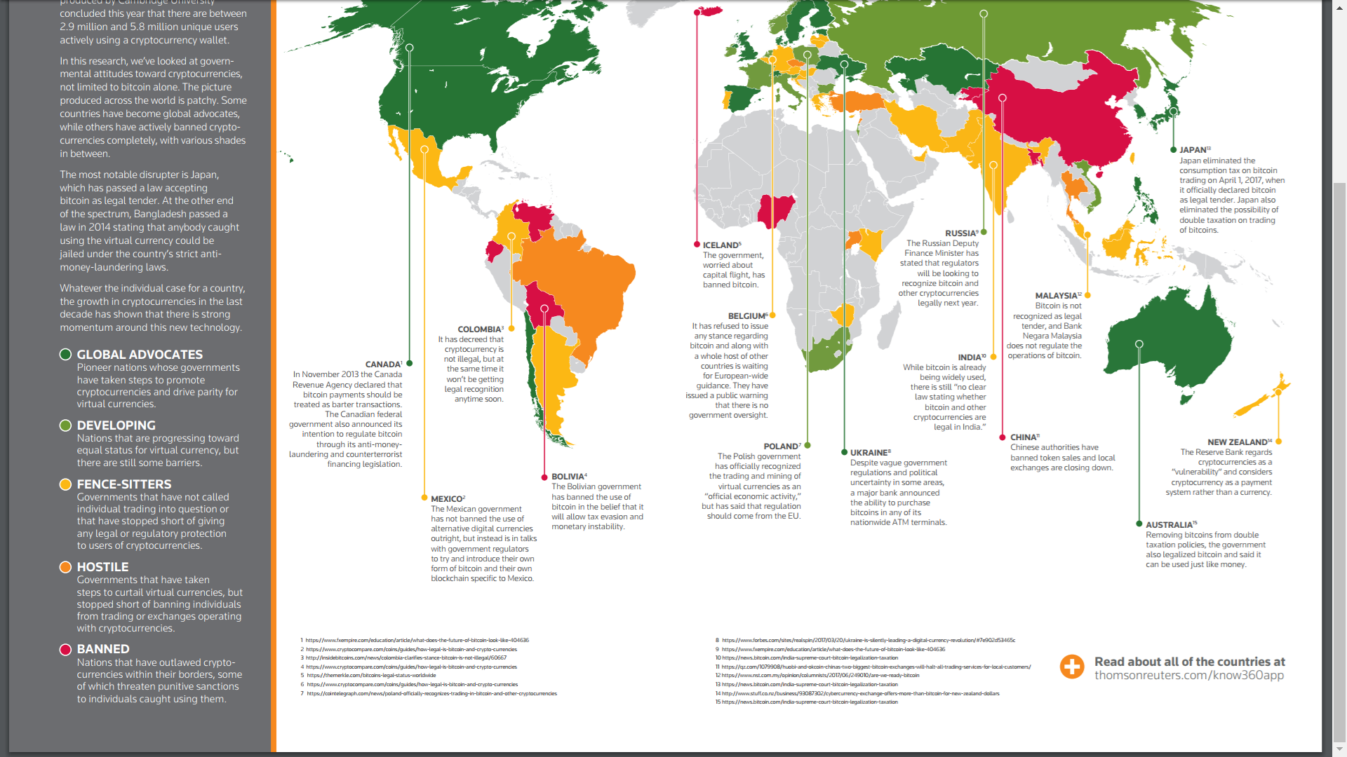
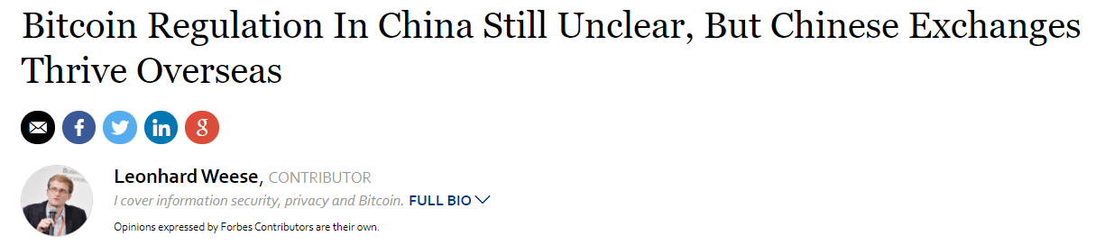
Bitcoin Acceptance

Slide 12



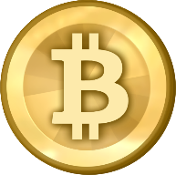
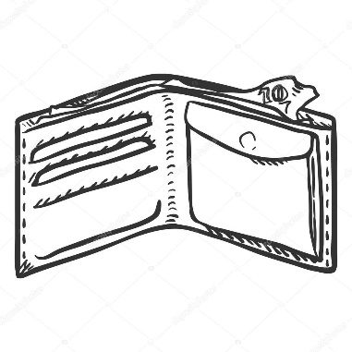
Bitcoin is Like Email
ron@saskatooncoinclub.ca
derick@gmail.com
The Internet
17u9X5c5ZjE2NeSBBP8sMHmgAMWuiawugj
1LGD5uXCwu9nguWbf7YnDXvfKEY36c8w3X
Notes:
Except that bitcoin isn’t copied – it is truly transferred

Slide 13






Where Can I Buy Bitcoin in Canada?
Services
Exchanges
Notes:
More here: https://coinforum.ca/discussion/1850/list-of-canadian-bitcoin-exchanges
Note: referral link behind Coinsquare
Services send coins to a wallet address you provide. Honeybadger operates Bitcoin ATMs
Exchanges follow Know Your Customer rules and may have restrictions on who can join, based on a location’s laws. These exchanges also accept wires for deposits and withdrawals.
Notice that I haven’t listed Coinbase, a popular exchange. They do not offer withdrawals to Canadians

Slide 14
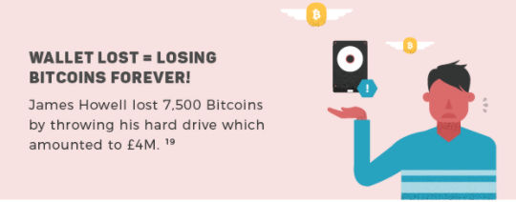
Where Can I Store Bitcoin?
Wallet
You own your private keys
Could be a:
Client app
Mobile app
Web app
Paper wallet
Hardware wallet
Typically can handle a single coin type, or a handful of different coins
Exchange
Exchange owns the private keys, secures and manages them for you
Typically offer a handful of coins, or a long list of coins
Notes:
Many Bitcoin purists will tell you that wallets are the only way to go
However – owning a wallet places all of the security and management responsibilities on you
You don’t have to manage these yourself – you can trust a third party, like an exchange
However, historically Exchanges have a bad track record for keeping money safe

Slide 15
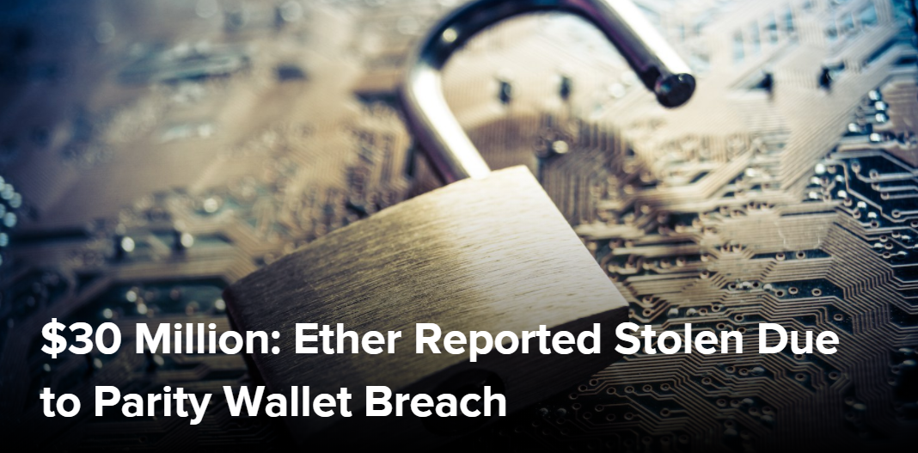
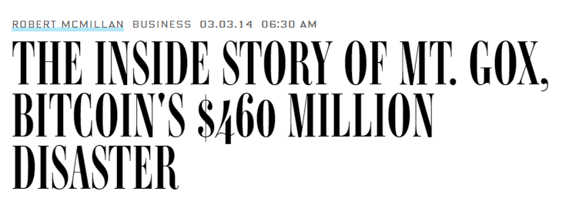
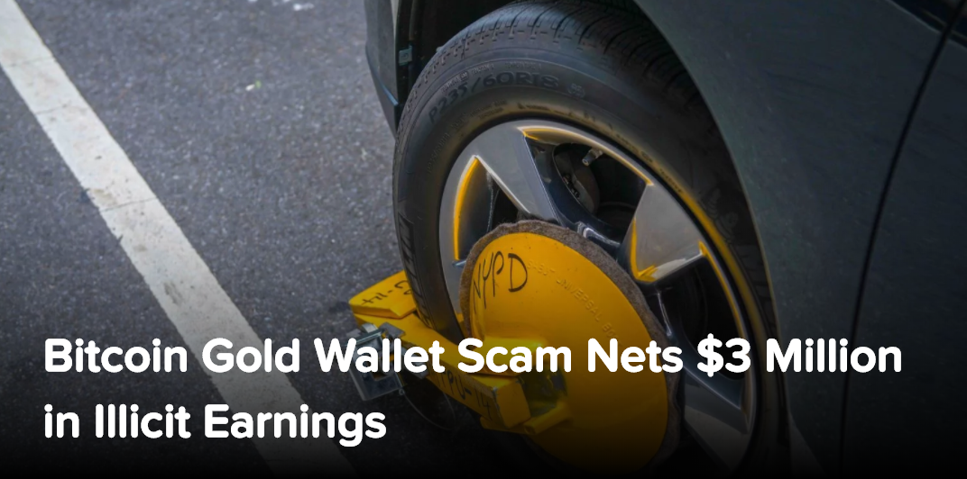
Be Careful & DYOR
Web sites, wallets and exchanges are powered by software
Can have vulnerabilities, can be hacked
You are trusting the teams behind them
Treat private keys like passwords
Use extreme caution on devices containing your wallets – they are one virus away from losing everything
This is a new market – limited regulation, no financial insurance
Diversify large portfolios across coins, wallets, and exchanges
Notes:
DYOR – Do Your Own Research
Know Your Customer laws means legitimate exchanges will ask for your personal information. DL, Passport, etc. Which means you are trusting them quite a bit.

Slide 16
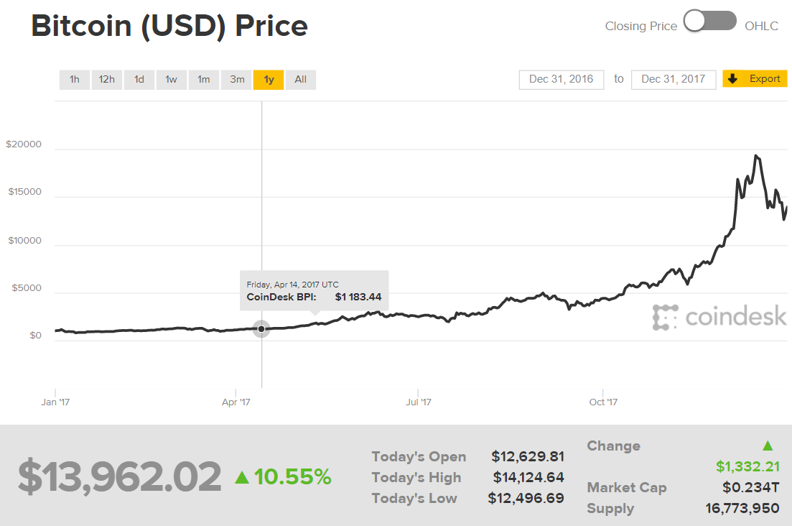
BTC
Notes:
This is the one year chart for Bitcoin, which has the BTC ticker symbol.
At the beginning of 2017, Bitcoin was around $1,000.
This shows the approximate value on Dec 31, one year later.
1,300 % growth in one year
You will see this pattern over and over again in crypto

Slide 17
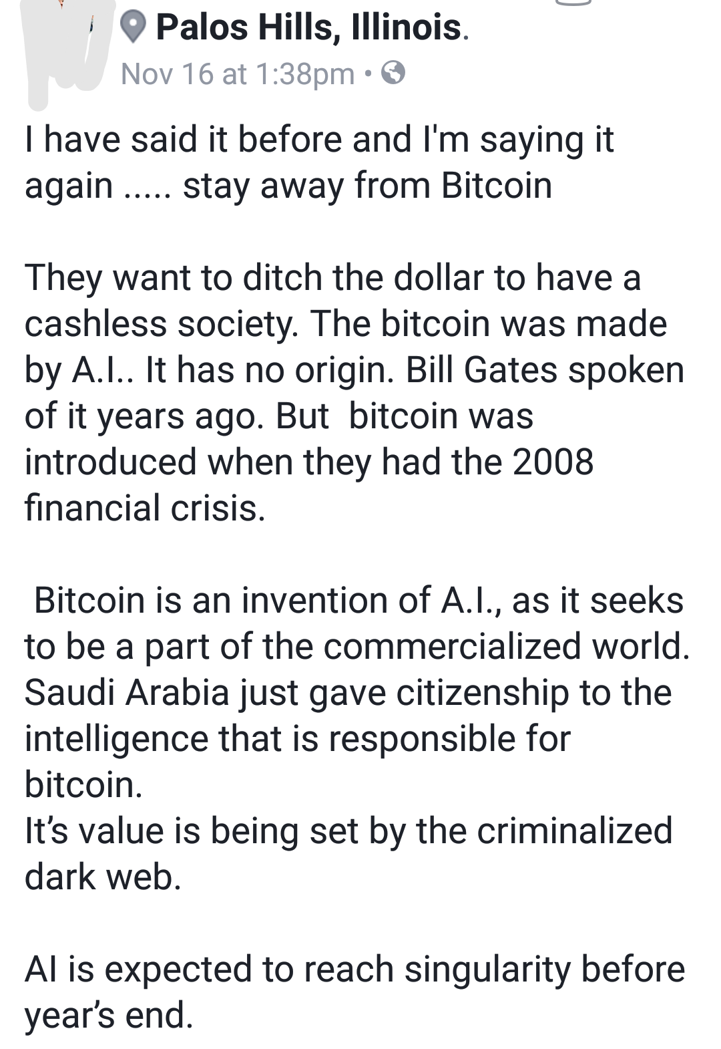
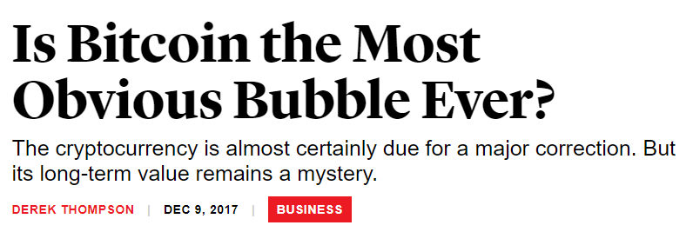
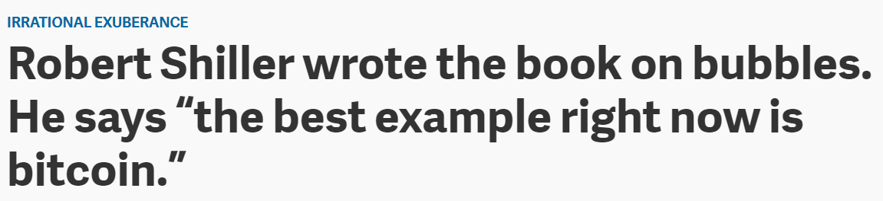
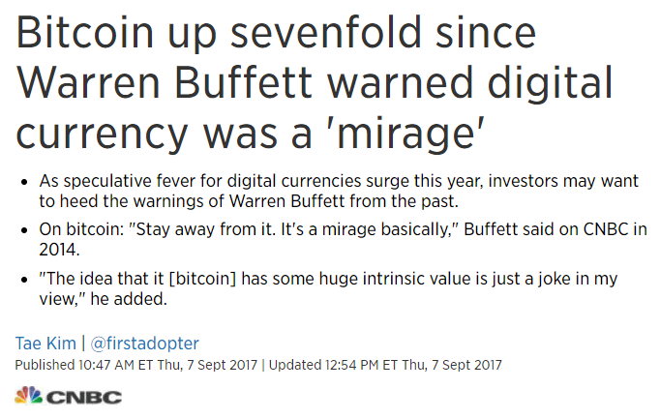
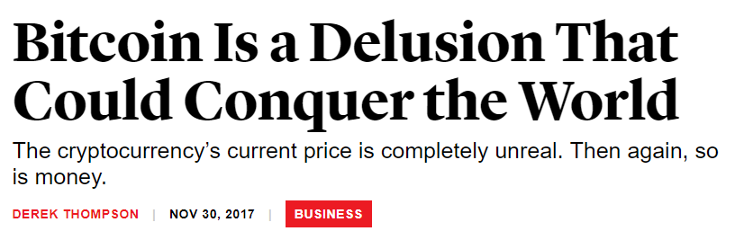
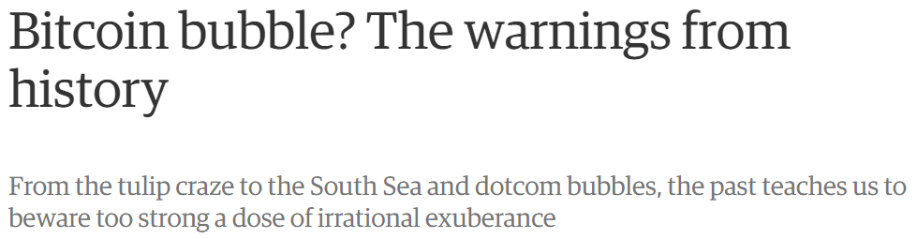
Notes:
There are several theories on Bitcoin in the press today
When you read these articles ask yourself this – does it appear the naysayers have a good grasp on what Bitcoin actually is?

Slide 18
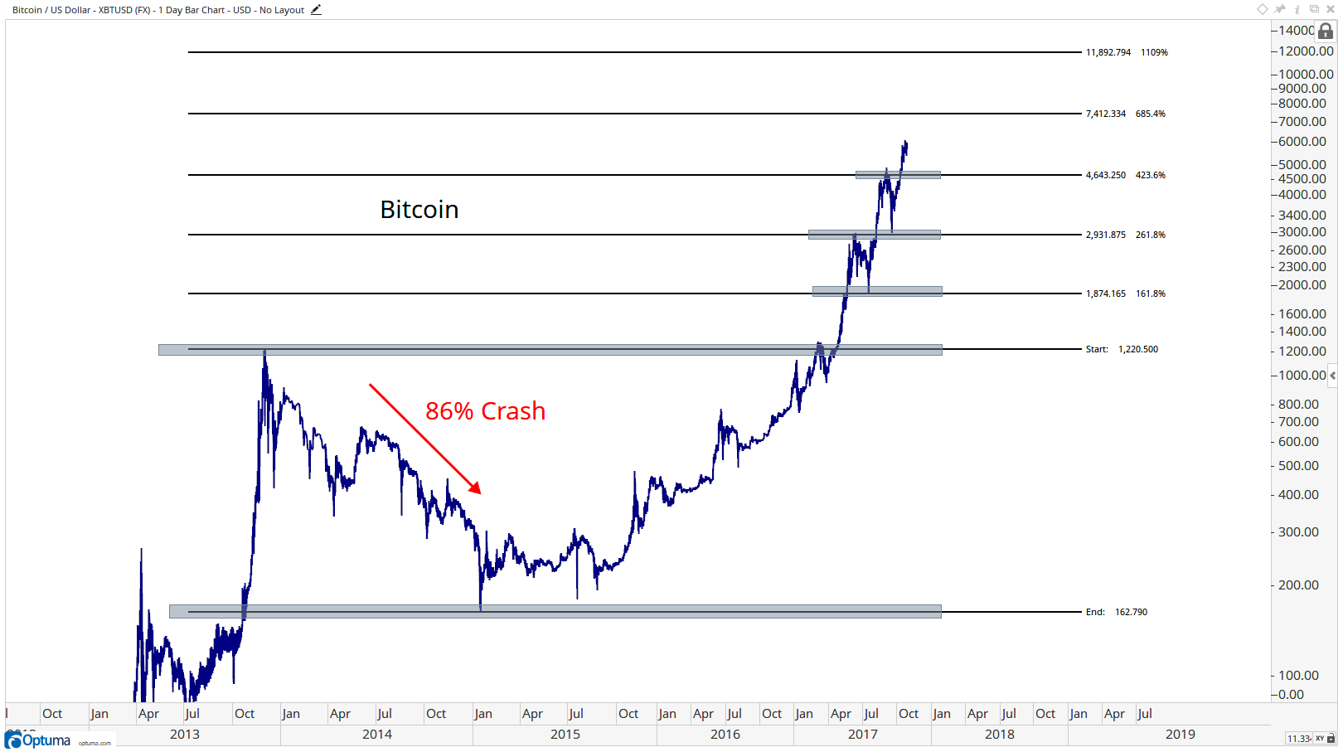
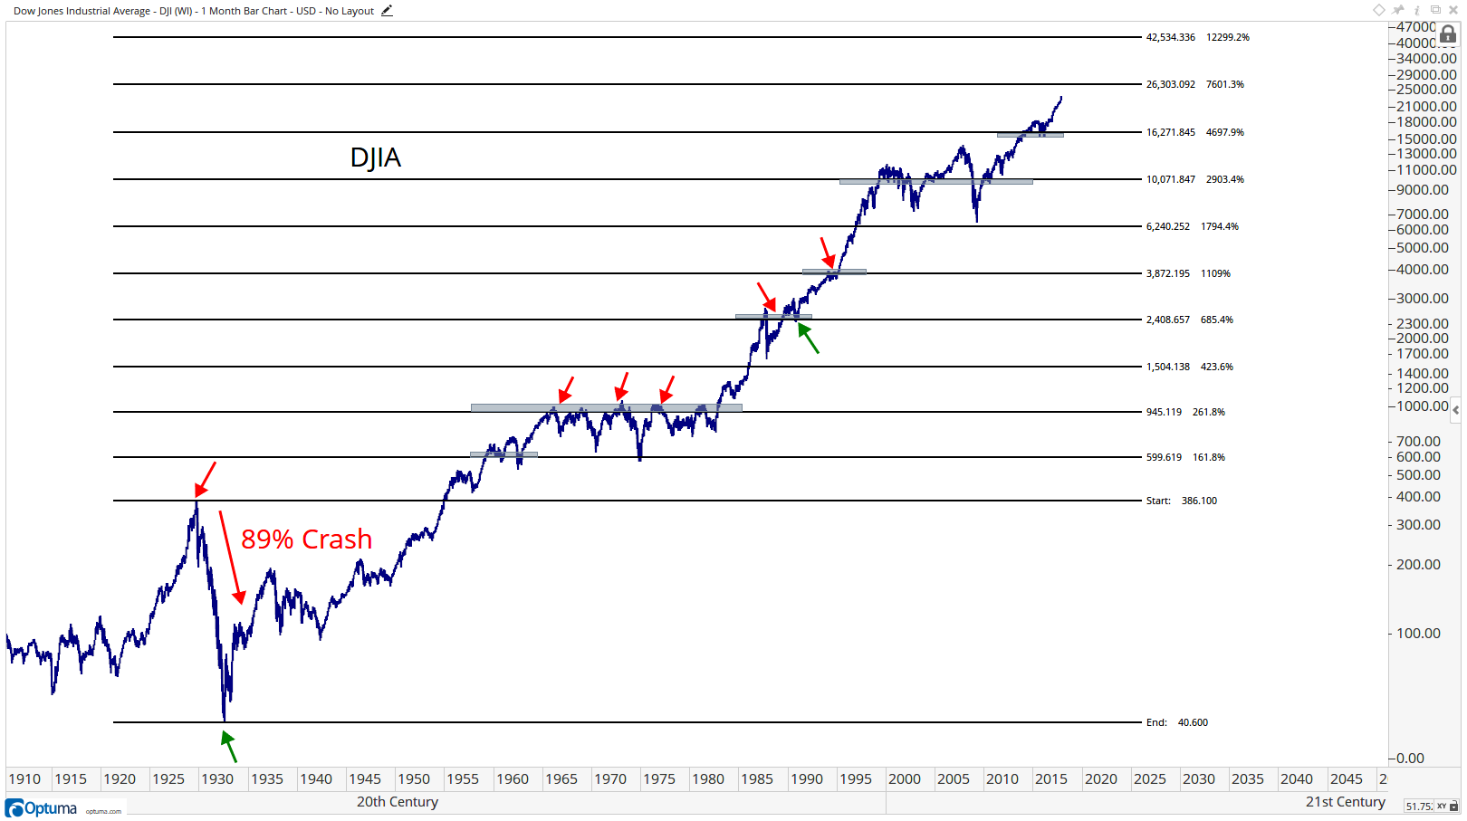
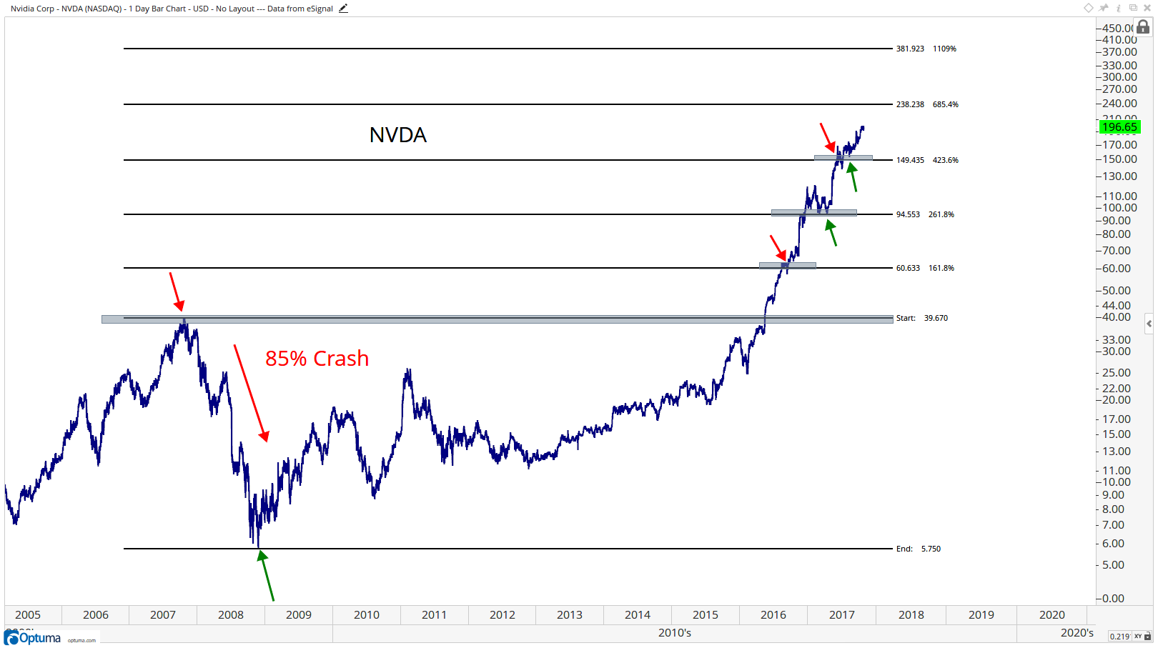
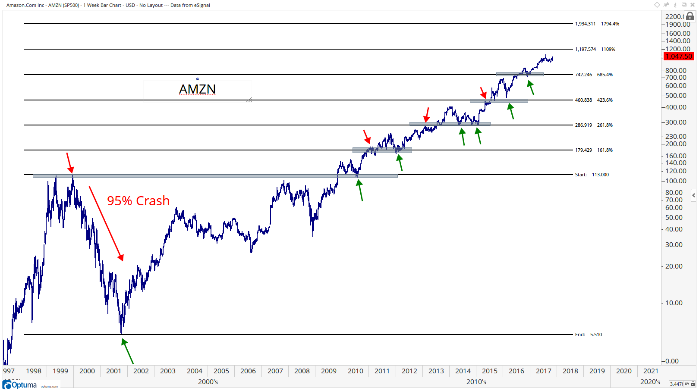
Other interesting
bubbles and crashes
Notes:
* Theory – this is what successful growth looks like. Corrections happen all the time after rapid increases

Slide 19
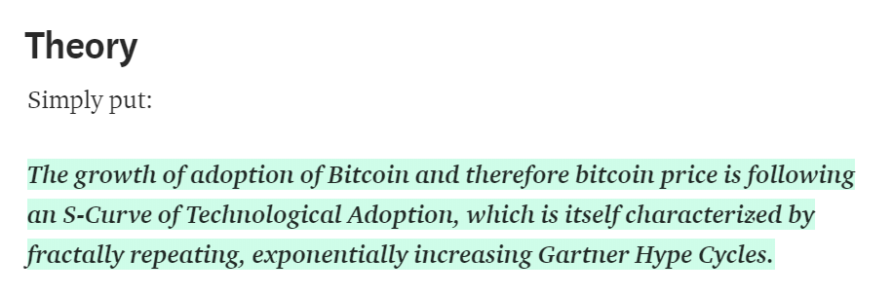
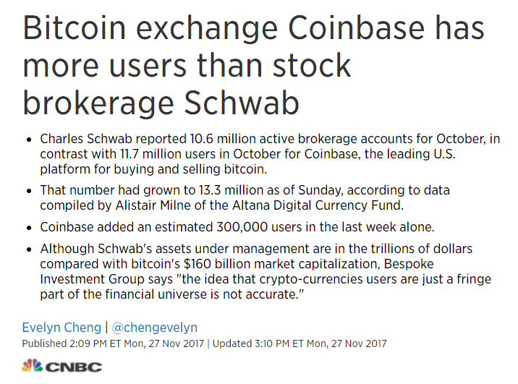
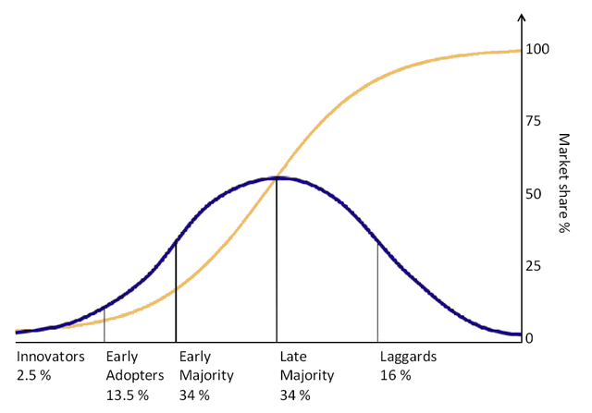
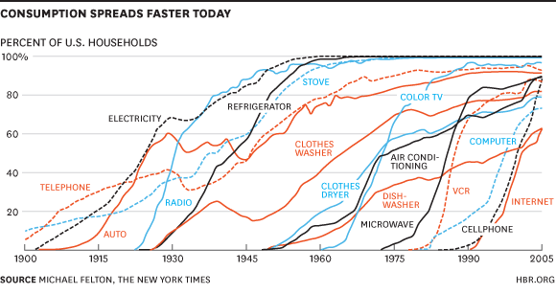

Notes:
One theory for Bitcoins rise in price is that it is following an adoption curve, like microwaves and computers
If we are seeing Bitcoin follow an adoption curve, what percentage adoption are we at so far?
Ask everyone in the room to share how many people they know (outside of the room) who own some crypto
Coinbase is just one crypto exchange of dozens if not hundreds worldwide

Slide 20
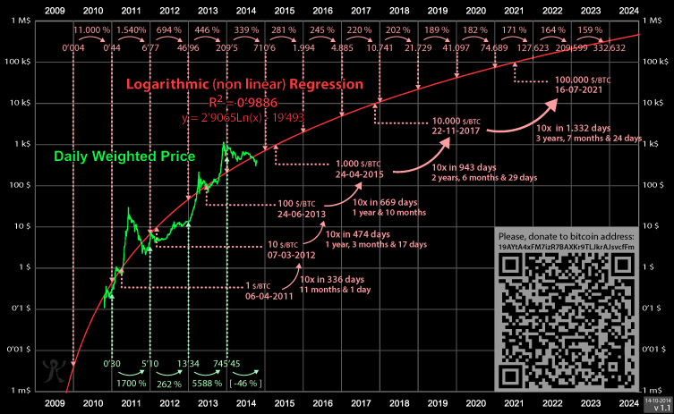
Notes:
Another theory for the massive rise in Bitcoin is that it is growing logarithmically
Today’s approximate price was predicted over three 3 years ago by this log curve
In the slides ahead, watch how the matching log curve changes over time
Diagrams from https://bitcointalk.org/index.php?topic=831547.0

Slide 21
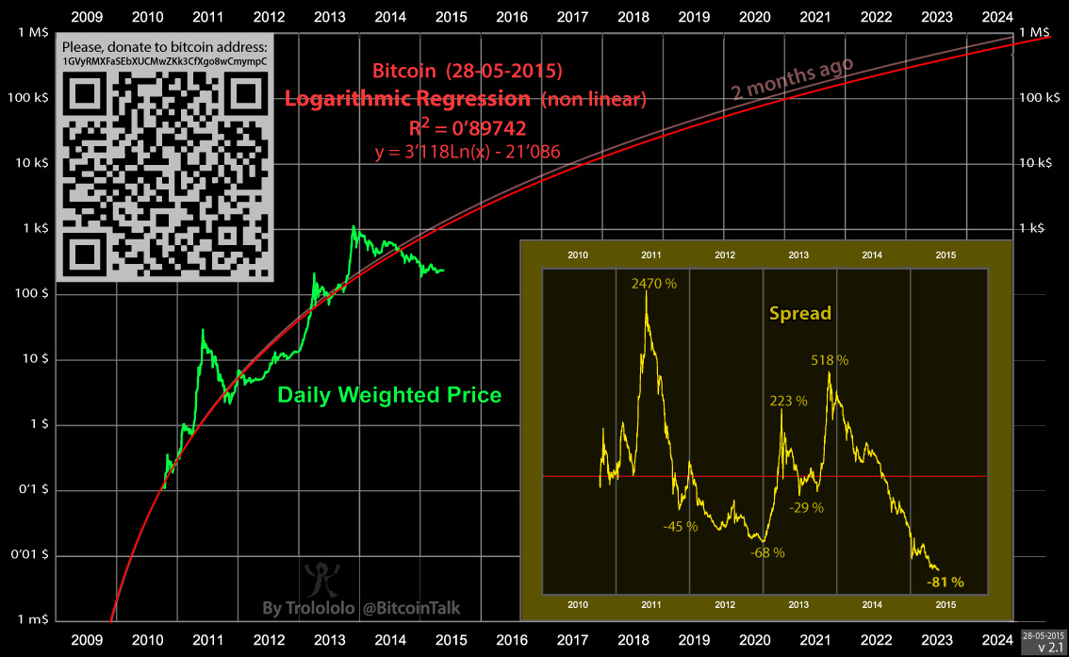

Slide 22
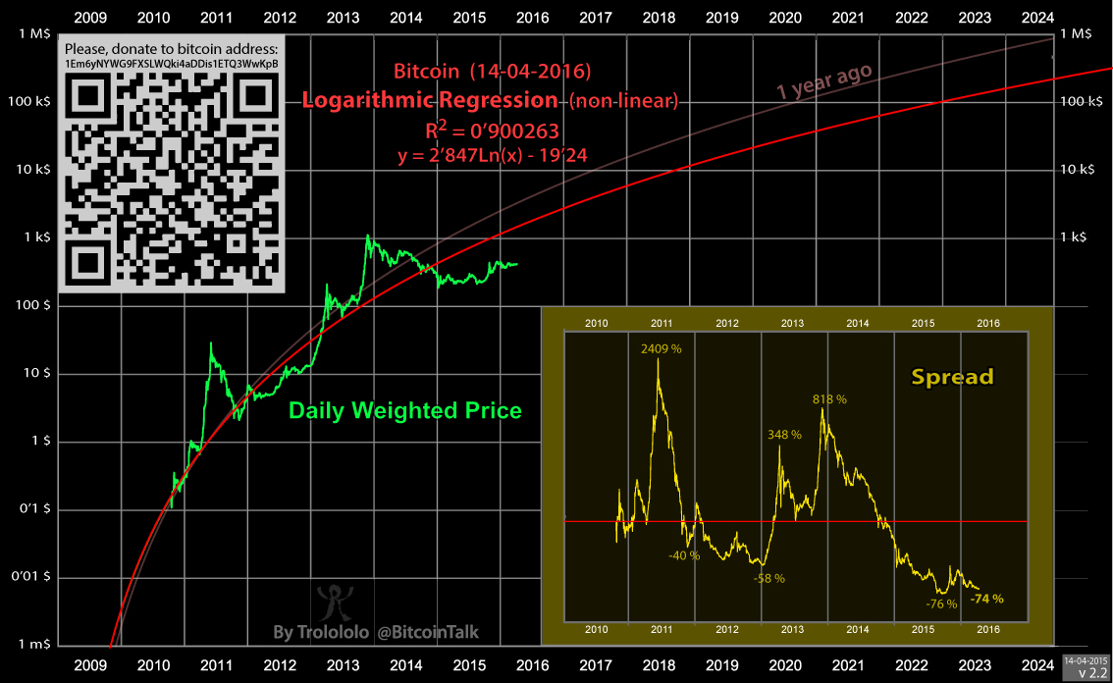

Slide 23
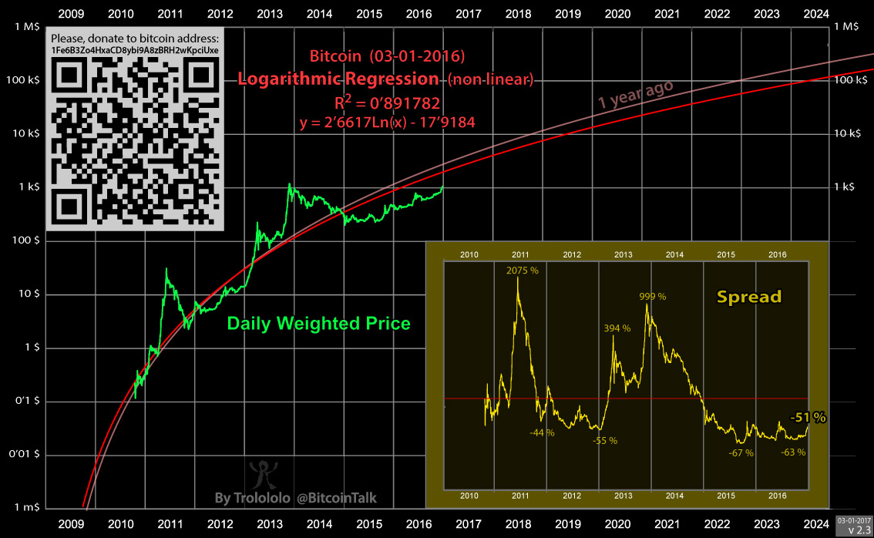

Slide 24
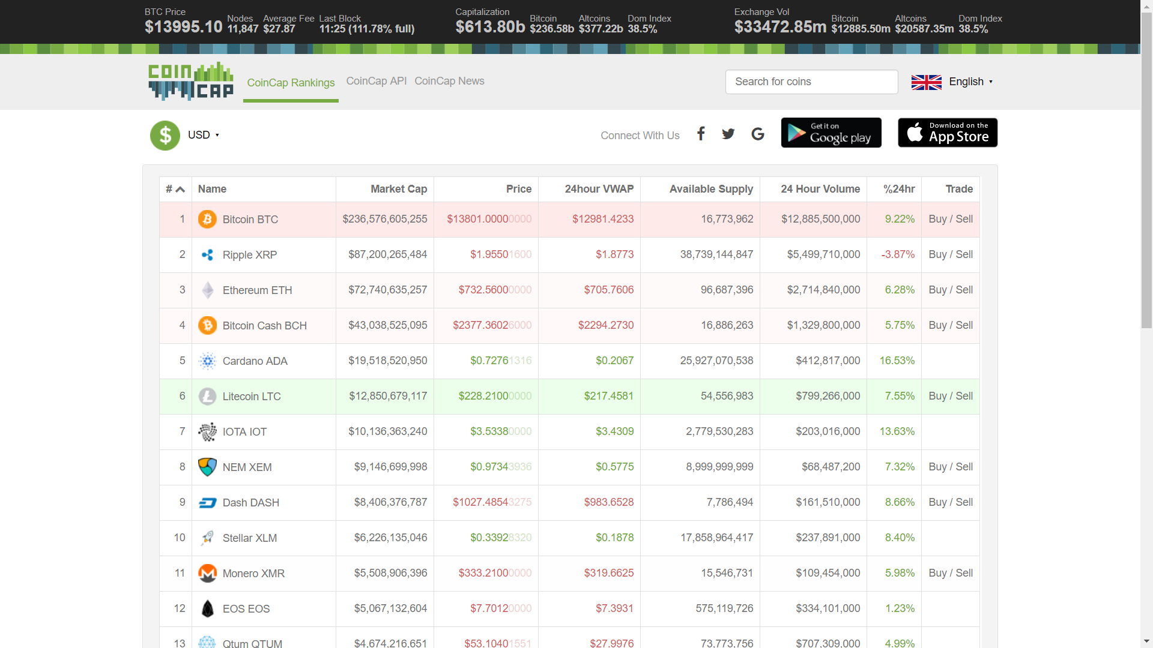
Dec 31, 2017
12:36pm
Notes:
Here’s a dynamic list of the top crypto coins by market cap
Note the Dominance Index, which shows the percentage of bitcoin capitalization within of all crypto.
People often talk of a “flippening”, or a date when Bitcoin will no longer be the #1 coin by market cap
IMHO, Bitcoin does suffer from some first mover disadvantages
Isn’t actively marketing – like other coins – counts on free marketing of the name
Free riders
The Innovators Dilemma

Slide 25
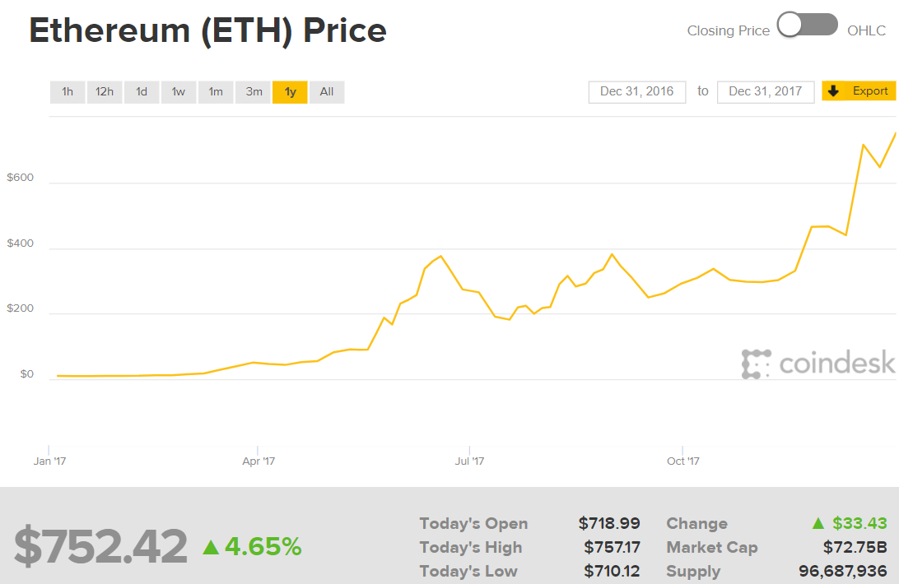
Notes:
Ethereum, the #3 coin listed earlier
Worth about $11 one year ago
Has grown by 6,700 % in one year

Slide 26

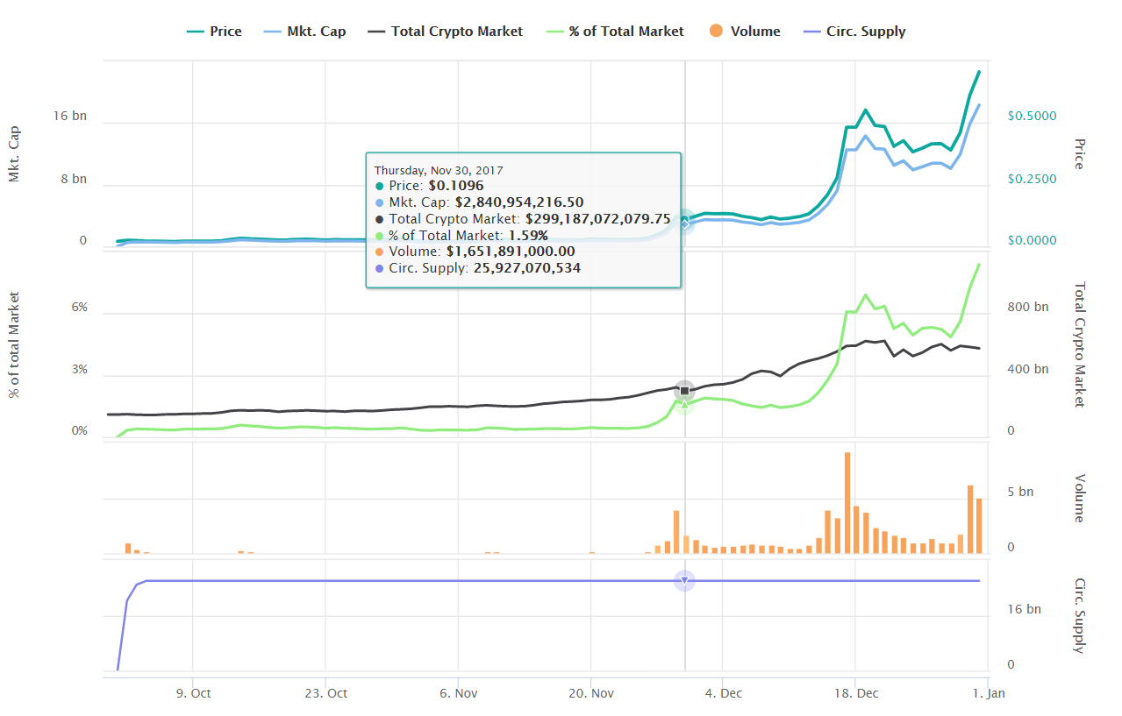
Cardano ADA
1
2
Notes:
Cardano ADA (#5 coin from the market caps earlier) has gone from 2 cents to 72 cents in three months
A 3,500% increase
Portfolio examples:
https://www.cryptocompare.com/portfolio-public/?id=154768
https://www.cryptocompare.com/portfolio-public/?id=158411

Slide 27
Scenario A: Acquire Some Bitcoin (BTC)
You want to store Bitcoin in a personal wallet
Create a Bitcoin wallet with a Wallet App
Get a wallet address
Use a Bitcoin purchase service and send Bitcoin to your address
Backup and secure your wallet’s private keys (in case your computer dies)
You want Bitcoin, but don’t want to manage your own wallet
Sign up for an exchange like Coinsquare
Purchase Bitcoin
Turn on Two Factor Authentication (2FA) for your exchange account
Backup and secure your 2FA codes (in case your phone dies)
Notes:
Use an Exchange if you want to purchase more than $1,000 of crypto

Slide 28

Scenario B: Acquire Some Ethereum (ETH)
You want to store Ether in a personal wallet
Create a Ether wallet with a Wallet App
Get a wallet address
Use an Ether purchase service and send Ether to your address OR Exchange Bitcoin for Ether using a service like
Backup and secure your wallet’s private keys (in case your computer dies)
You want Ether, but don’t want to manage your own wallet
Sign up for an exchange like Coinsquare
Purchase Ether
Turn on Two Factor Authentication (2FA) for your exchange account
Backup and secure your 2FA codes (in case your phone dies)

Slide 29
Scenario C: Acquire Some Cardano (ADA)
Get some Bitcoin (Scenario A)
Sign up for an exchange that trades Cardano, like Bittrex
Get your Bitcoin address on Bittrex
Send your Bitcoin to your Bittrex Bitcoin address
Purchase Cardano on Bittrex with your received Bitcoin
Turn on 2FA
Backup your 2FA codes (in case your phone dies)

Slide 30
Scenario D: Store your Crypto Safely
Get a wallet app for the coin(s) you want to store
You may need a unique wallet for each type of coin
Get a wallet address for each type of coin
Withdraw your coins, sending them to exactly the right address for that type of coin
Follow instructions carefully – each coin differs
Backup and secure your wallet’s private keys (in case your computer dies)
More security practices…

Slide 31
Scenario E: Cash Out Baby!
(If you don’t have one already) sign up for an exchange that supports withdrawals (like Coinsquare or QuadrigaCX)
Pay attention to wire fees and exchange rates. For example, Coinsquare has higher wire fees but also higher crypto prices.
Convert your coins to one of the coins supported by your exchange
Withdraw your coins, sending them to your exchange
Sell coins for dollars on your exchange
With your exchange, initiate a Wire transfer to your bank account

Slide 32
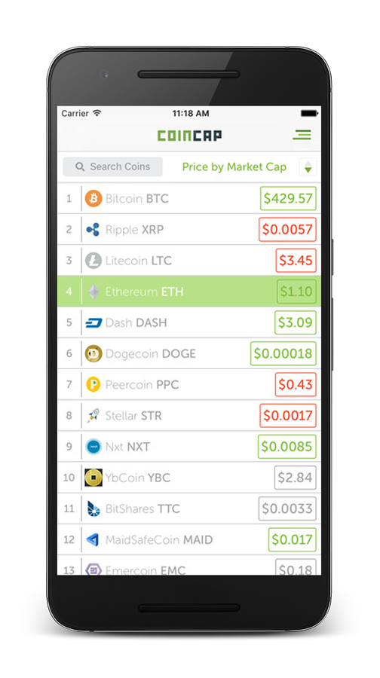
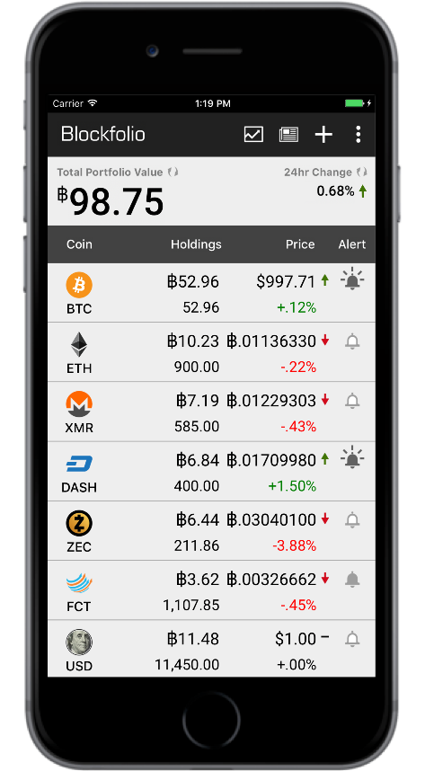

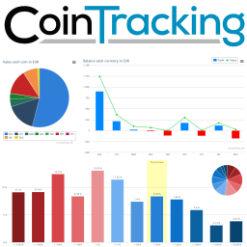
Monitoring Your Portfolio
In my personal order of preference…

Slide 33
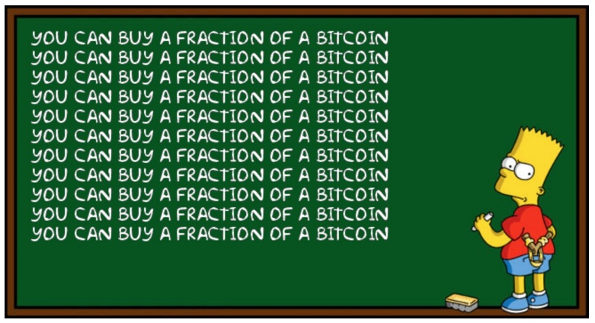
Crypto Tips
Crypto-currency is highly divisible
You can purchase $50 of Bitcoin
Don’t worry about whole numbers
It is easy to move coins
Get the address details right!
No bank protections
Watch for daily withdraw limits on exchanges – can take forever to withdraw
Watch for transfer fees
Wallets let you choose, choose wisely
Exchanges set standard fees, may be high for small transfers
Bitcoin ATMs have very high fees
High-cap coins are highly volatile
When buying or selling, don’t rush
Don’t over trade – #HODL
Don’t FOMO, be careful about buying the top
Beware of low-cap coins
They can be difficult to sell
Beware of Initial Coin Offerings (ICOs)
Supporting exchanges unknown upfront
Coins may be illiquid for months or years
Many scams
Some great opportunities though!
Watch for newly listed coins
Some great opportunities
DYOR
Notes:
ICO = Initial Coin Offerings
HODL = Hold
FOMO = Fear Of Missing Out
A Satoshi is 1/100,000,000 of a Bitcoin

Slide 34
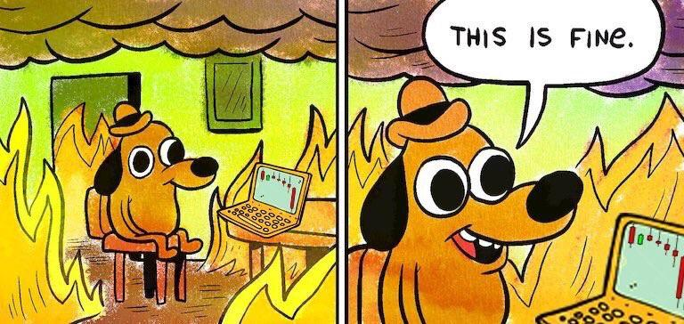
More Crypto Tips
Pay attention to the BTC value of your crypto, not just USD
If your Altcoins aren’t doing better than Bitcoin, why hold Altcoins?
What kind of crypto-investor do you want to be?
Active trader or 100x thrill seeker?
Buy and HODL – highly recommended starting point
Active trading can have tax implications (like stock trading)
Every coin has a business model
Does it make sense? Is it real?
Would you invest in this as a company?
Is it pushing the state of the art?
Does it have a real team, with great experience?
What do others think about it?
Watch out for coin shilling
#DYOR
Choose coins with long term value and viable roadmaps

Slide 35
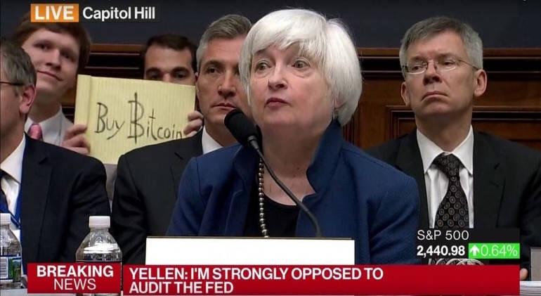
Q&A

Slide 36
Thanks!
http://bit.ly/DC-BTC

Slide 37
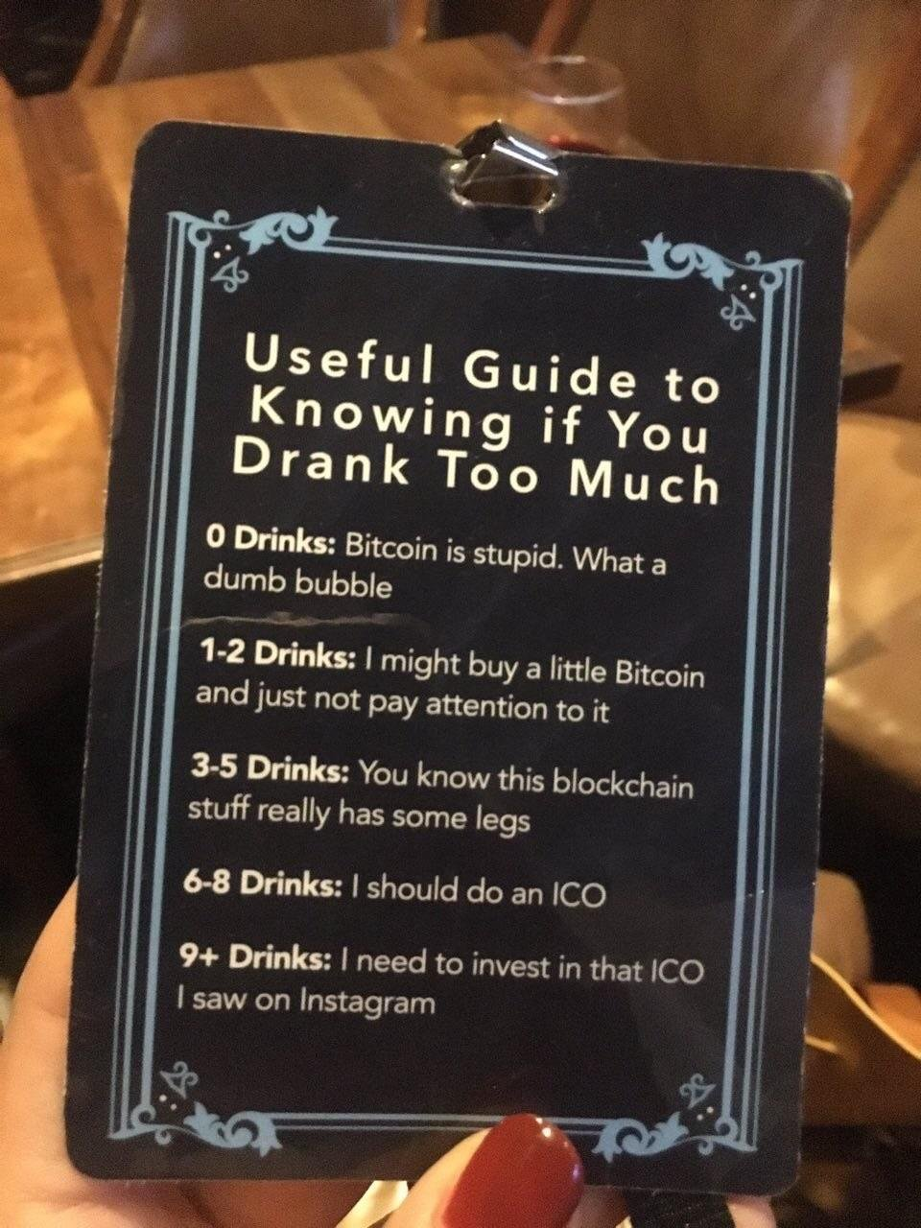






Slide 38







Slide 39





Slide 40







Slide 41




Slide 42







Slide 43





Slide 44




